Slide 1
Employee Data Analysis Using excel
Student Name : V.Yuvasree
Register number : 312214972
Department: Commerce
College: Annai veilankanni’s college for women
NMID : asunm1483312214972

Slide 2
Project title
Employer performance analysis using excel

Slide 3
Agenda
Problem statement
Project overview
Our solution and proposition
Dataset description
Results and discussion
Conclusion

Slide 4
Problem statement
Accurately evaluate employee performance
IDENTIFY strengths, weaknesses, opportunities and threats(swot analysis)
Develop targeted interventions and training programs
Inform talent management decisions (promotions, successions)

Slide 5
Project overview
Focus on identifying key predictors of performance, area of improvement and opportunities for growth and development.
Develop data- driven insights to inform talent management decisions, training progorams and leadership development initiatives.

Slide 6
Who are the end users?
Organizational development teams.
Employee
Employee development teams
Hr business partners
Senior leadership

Slide 7
Our solution and it’s value proposition
Identify top performance
Boost productivity
Enhance employee engagement
Pinpoint skill gaps

Slide 8
Dataset description
Description: this data set contains information on employee performance, demographics, and development activities.
fields :
Employee ID
Name
Salary
Department
Job role

Slide 9
THE “WOW” IN OUR SOLUTION
Automated performance scoring for unbiased evaluations
Personalized development plans for targeted growth and improvement
Real-time feedback and coaching for continuous development

Slide 10
Modelling
Regression Analysis Decision Trees Clustering Analysis Predictive Modeling Propensity Scoring Survival Analysis Network Analysis

Slide 11
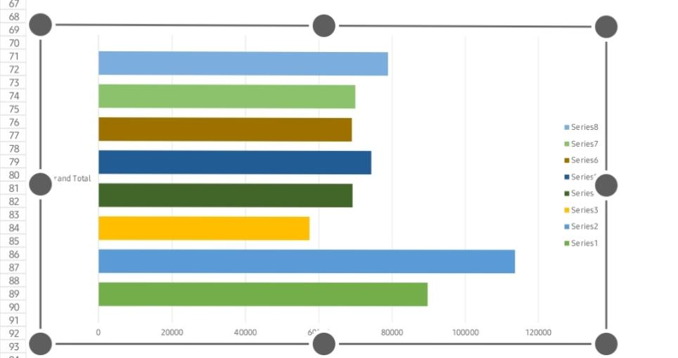
Results

Slide 12
Conclusion
Employee performance analysis is a critical component of talent management, enabling organizations to make data driven decisions ,drive business outputs and enhance employee experience. By leveraging advanced analytics modelling techniques.

